Slide 1
Introduction to Ethical Theories
How do YOU decide what is right and what is wrong?

Slide 2
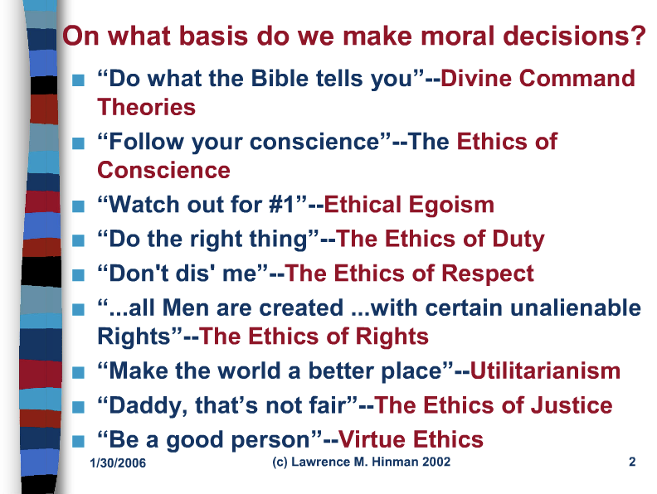

Slide 3
The Ethical Point of View
Virtually everybody shares “core values”
  Life
  Happiness
  Ability to accomplish goals
Two ways to view world
  Selfish point of view: consider only own core values
  Ethical point of view: respect other people and their core values

Slide 4
Defining Terms
Society:
  Association of people organized under a system of rules
  Rules: advance the good of members over time
Morality
  A society’s rules of conduct
  What people ought / ought not to do in various situations
Ethics
  Rational examination of morality
  Evaluation of people’s behavior

Slide 5
Why Study Ethics?
Not everyone can do what they want
Ethics: A way to decide the best thing to do
New problems accompany new technologies
“Common wisdom” not always adequate

Slide 6
Scenario 1
Did Alexis do anything wrong?
Who benefited from Alexis’s course of action?
Who was hurt by Alexis’s course of action?
Did Alexis have an unfair advantage over her high school classmates?
Would any of your answers change if it turns out Alexis did not win a college scholarship after all?
In what other ways could Alexis have accomplished her objective?

Slide 7
Scenario 2
Did the anti-spam organization do anything wrong?
Did the ISPs that refused to accept email from the blacklisted ISPs do anything wrong?
Who benefited from the organization’s action?
Who was hurt by the organization’s action?
Could the organization have achieved its goals through a better course of action?

Slide 8
Scenario 3
Did the Traffic State Police do anything wrong?
Who benefited from the actions of the traffic police?
Who was harmed by the actions of the traffic police?
What other courses of action could the traffic police have taken to achieve its objectives?

Slide 9
Scenario 4
Should you recommend release of the product next week?
Who will benefit if the company follows your recommendation?
Who will be harmed if the company follows your recommendation?
Do you have an obligation to any group of people that may be affected by your decision?

Slide 10
More on Ethics
Studied for over 2,400 years - Socrates & Plato
Ethics: rational, systematic analysis
  “Doing ethics”: answers need explanations
  Explanations: facts, shared values, logic
Ethics: voluntary, moral choices
Many different theories - which is best?
Workable ethical theory: produces explanations that might be persuasive to a skeptical, yet open-minded audience

Slide 11
Subjective Relativism
Relativism
  No universal norms of right and wrong
  One person can say “X is right,” another can say “X is wrong,” and both can be right
Subjective relativism
  Each person decides right and wrong for himself or herself
  “What’s right for you may not be right for me”
Notes:
Over view of ethical theories starts with Relativism - 2 type
SR
CR
How do we decide if a particular ethical theory is useful? A useful theory allows proponents to examine moral problems reach conclusions and defend these.
e.g. Answer this “Why do you think that doing X is right?” Needs a logical answer otherwise is a weak defence.
So in this part of the course we will look at some different theories and reject those that are not based on logic and reasoning.

Slide 12
Case for Subjective Relativism
Well-meaning and intelligent people disagree on moral issues
Ethical debates are disagreeable and pointless
Notes:
Rational people disagree on abortion. Morality is not like gravity they say, it is not something that is ‘out there’. Each person creates their own morality.
Debates don’t tell us who is right. 30 years people have been debating in the US. With SR we don’t need to reconcile different viewpoints.

Slide 13
Case Against Subjective Relativism
Blurs distinction between doing what you think is right and doing what you want to do
Makes no moral distinction between the actions of different people
Some are attracted to SR because they believe in tolerance. But SR and tolerance are two different things
Decisions may not be based on reason
Not a workable ethical theory
Notes:
Last line of defence is “who are you? to tell me” If morality means doing what you like, then it doesn’t meant much if anything at all.
Hitler V Mother Theresa. Even saying “as long as nobody is harmed” is problematic because you who is to define harm as there is no universal norms with SR so this is a contradiction in SR.
Tolerance is a universal norm, SR say there are no universal norms. SR and tolerance are NOT the same thing
People can use any rationale to reach decisions, e,g, dice, tarot card, chicken entrails.
So, if you are trying to argue that your decision is right SR is self defeating because you cannot do this so it is self defeating Nobody’s conclusions are any more valid that anybody else’s. SR has therefore no logical reasoning so is unworkable.

Slide 14
Cultural Relativism
What is “right” and “wrong” depends upon a society’s actual moral guidelines
These guidelines vary from place to place and from time to time - car crash secenario
CR says ‘A particular action may be right in one society at one time and wrong in other society or at another time’
Notes:
2nd type of relativism.
Car hits pedestrian while speeding. You are passenger and friend is driving. You can lie to get friend off. What right has your friend to expect this.
Definite right to expect me to testify to the lower speed
Some right ditto
No right ditto
What should you do in court?
Testify he was doing 20 MPH, lie
Not testify? Tell truth
90% Norwegians would not testify to lower speed I.e. the would tell truth
10 of Yugoslavs would testify, I.e. lie
75 of US and Canadians would not testify
50 of Mexicans
CR cite this to show that CR is a fact and say we should pay attention to these types of differences.

Slide 15
Case for Cultural Relativism
Different social contexts demand different moral guidelines
It is arrogant for one society to judge another
Morality is reflected in actual behavior
Notes:
It’s unrealistic to assume that the same set of moral guidelines can work for all societies for all time. E.g. environmental attitudes, attitudes towards sex, marriage, family structure etc
We have no right to judge those who lived in Peru in 15th century.
How people behave tells us more about a society than any hypothetical discussions about how they ought to behave. I.e favour descriptive explanations

Slide 16
Case Against Cultural Relativism
Because two societies do have different moral views doesn’t mean they ought to have different views
It doesn’t explain how moral guidelines are determined
It doesn’t explain how moral views evolve
It provides no way out for cultures in conflict
Because many practices are acceptable does not mean any cultural practice is acceptable (many/any fallacy)
Societies do, in fact, share certain core values
Only indirectly based on reason
Therefore a significantly weak ethical theory
Notes:
- Normative V descriptive. But must be careful not to mix up actions and moral behaviour. E.g. human sacrifice V building aquaducts in a drought.
- Moral guidelines in a society may be different than individual moral guidelines. A visitor asking an individual may not get you the right answer, will get individual moral view not societal. They may be imposed against the wishes of the people. They might be the morals of an evil leader, e.g. Hitler.
- Black Americans broke the law when universities were segregated. The were considered morally wrong at the time but now are considered to have been right. Moral attitudes evolved. This would not have happened if we accepted CR attitude I.e. that different contexts demand different moral guidelines.
- e.g. conflict between Israel and Palestine. Values of each society may harm the other, yet CR say each is right.
- Just because many types of moral behaviour are acceptable doesn’t mean that any type is acceptable. Many/any is an often used philosophical argumen.t So we can can judge other societies. They are not all morally equivalent.
- Core values such as right to life, liberty etc, no gratuitous killing, no paedophilia etc
Many moral guidelines are a result of tradition, we behave this way because we always have done so, not because it makes any logical sense, e.g female circumcision
- CR say there are no universal moral guidelines, but many anthropologists have identified universal taboos so CR are on weak ground if in this contention. With CR it would be impossible to say whether Britain or Nazi Germany was the better society in the 1940s.

Slide 17
Divine Command Theory
Good actions: those aligned with God’s will
Bad actions: those contrary to God’s will
Holy books reveal God’s will.
We should use holy books as moral decision-making guides.
Notes:
So we can use Holy Books to guide us morally.

Slide 18
Case for Divine Command Theory
We owe obedience to our Creator.
God is all-good and all-knowing.
God is the ultimate authority.
Notes:
Who made us all and therefore we are dependant on God for our very lives and obligated to follow his rules.
Because God is all knowing we should align our moral guidelines with God’s
Most people are religious therefore are more likely to follow God’s law than those made by humans. Pragmatic argument.

Slide 19
Case Against Divine Command Theory
Different holy books disagree
Society is multicultural, secular
Some moral problems not addressed in scripture
“The good” ≠ “God” (equivalence fallacy)
Based on obedience, not reason
Notes:
Whose holy book do you follow?
What about now, different religions in different countries and societies and more people do not believe in God.
The internet is not mentioned, so we must infer moral guidelines from what is written in holy books. That means interpretation and different religious scholars disagree on these.
Another philosophical argument, equivalence fallacy. God may be good but is everything that is good also God? No. So if there are some things that are good that are not God then relying of Divine Command Theory is weak. E.g suppose God said “Thou shalt commit adultery” would you say that was good just because God said it? No. But you might also argue that god would not say such a thing because it is not a good thing in itself. This then means that some good things are outside of God. It also means that we can discuss ‘good’ without reference to God and that some good or morally right behaviour is not dependent on God. Therefore we cannot make an entire moral system based on divine command.
We need to have moral guidelines that are based on logical reasoning not blind obedience. Often these religious arguments cannot convince skeptics who hold different beliefs.

